Slide 1
DOM Animations
Mr Mack 2022

Slide 2
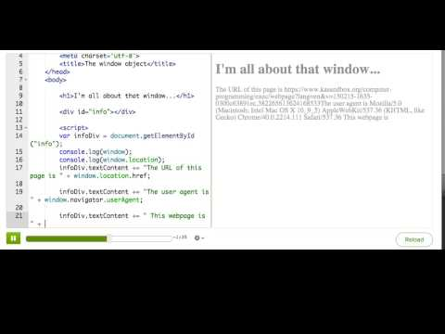
The window object

Slide 3
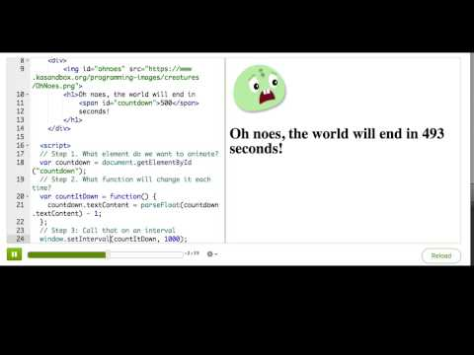
Animating DOM with setInterval

Slide 4
Practice: Stopwatch
In this challenge, you'll turn this webpage into a simple stopwatch. First, use setInterval to call the countUp function. Then add code to the countUp function that increments the value of the '#seconds' span by 1 each second.
Make it start

Slide 5
Practice: Stopwatch
In this step, you'll make the stop button work by figuring out what to change in the stopCountUp function (and you may have to change other parts, too).
Make it stop

Slide 6
Practice: Stopwatch
Click the button to make sure it stops the clock. We'll check the result a second after you click, so wait for the checkmark to appear.
Stop the clock!

Slide 7
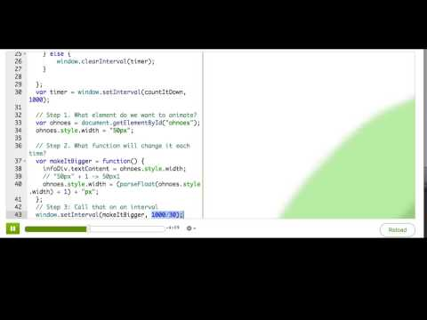
Animating styles with requestAnimationFrame

Slide 8

Practice: Catwalk
This webpage contains a cat that's already animated, but that's only because it's an animated GIF. For this challenge, you'll make the cat move across the screen, too, in JS. Change the walkTheCat function so that it updates the cat's left position property, and then make sure it's called repeatedly using the window.requestAnimationFrame function.
Make the cat walk

Slide 9
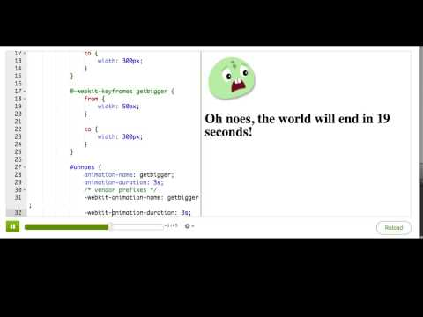
Animating styles with CSS animations

Slide 10
What DOM animation technique should you use?
You've now seen three techniques that let you animate parts of your webpage: window.setInterval/setTimeout, window.requestAnimationFrame, and CSS animations/transitions.
When you're considering what technique to use, you should consider these questions:
Can it actually do what I want to do?
How well does this technique perform? (Does it slow down the browser/computer?)
How accurate does my timing need to be?
Does it work in all the browsers that I want my webpage to work in?

Slide 11
What DOM animation technique should you use?
When making webpages, we're very concerned about performance, so we like to consider that as the most important criteria. However, browser performance does change when new browsers come out, and mobile browsers can perform very differently from desktop browsers, so the technique that performs best today may not be the technique that performs best tomorrow. Currently, CSS animations/transitions are the most performant, then requestAnimationFrame, then setInterval.
However, CSS can't do everything. For example, to draw pixels and shapes in a <canvas> tag, you have to call functions like fillRect(), you can't use CSS. You would need to use requestAnimationFrame or setInterval to call those functions periodicially instead. In fact, that's what we do here on Khan Academy, in our ProcessingJS environment. ProcessingJS is a JS library that writes out to a <canvas> tag, and if you define a draw() function in your code, then ProcessingJS uses setInterval to call that draw() function repeatedly based on the frameRate.

Slide 12
What DOM animation technique should you use?
Sometimes, you want to call JavaScript functions periodically, but not because you want to animate something on the page. You might be polling a server for updates, like Twitter does when it updates its realtime feed. In that case, you can just use setInterval, and it doesn't matter that the timing isn't accurate, because you're only calling it every minute or so. That's what we do on Khan Academy on the help requests page, to continuously check for new help requests every 2 minutes.
Of course, you should keep browser compatibility in mind. If you're writing code that needs to work in IE9, then you can't use requestAnimationFrame or CSS animations. You need to use a combination of techniques that work across the browsers, or find a library that does that for you, like Velocity.js.

Slide 13
What DOM animation technique should you use?
There is a lot more to learn about all of these techniques. Follow these links to learn more:
CreativeJS: requestAnimationFrame
CSS Tricks: Using requestAnimationFrame
MDN: Guide to using CSS animations
TutsPlus: Beginners intro to CSS animation
The art of web: CSS animation
CSS Animation: An interactive guide

